Slide 1
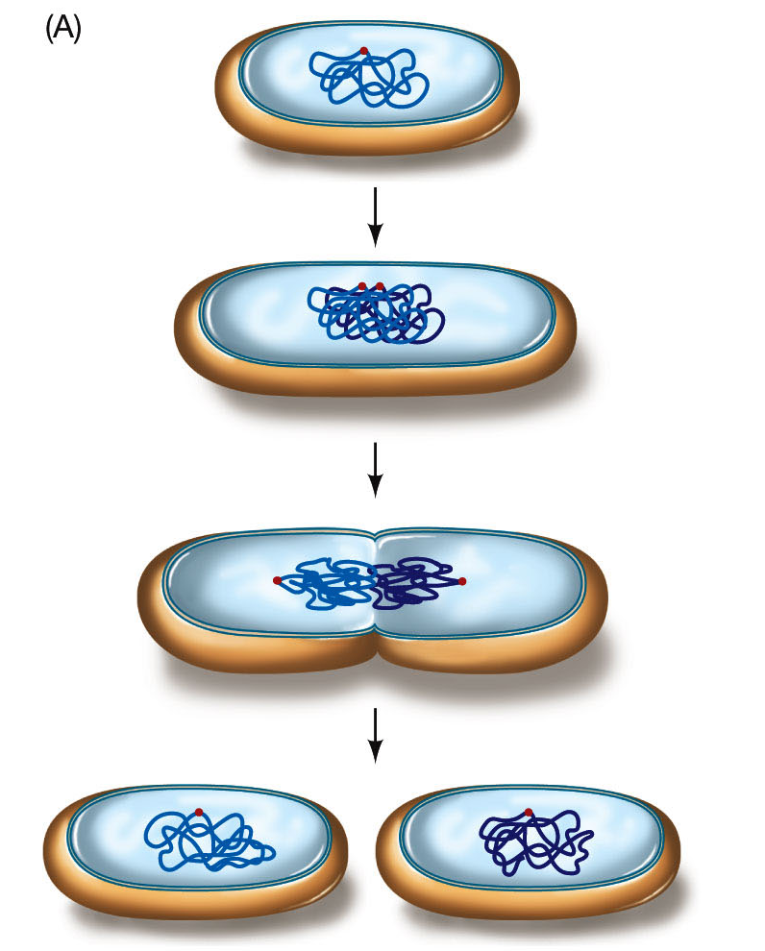
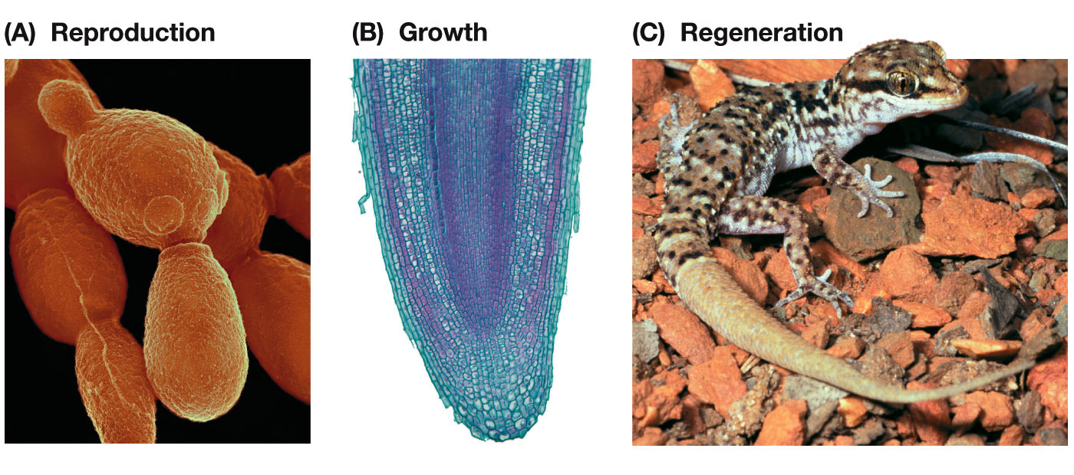
Intro to Biotech
Lect.4
How is DNA propagated ?
1.
2.
3.
Prokaryotic
Eukaryotic
Reproduction
Reproduction
Growth
Regeneration/Repair

Slide 2
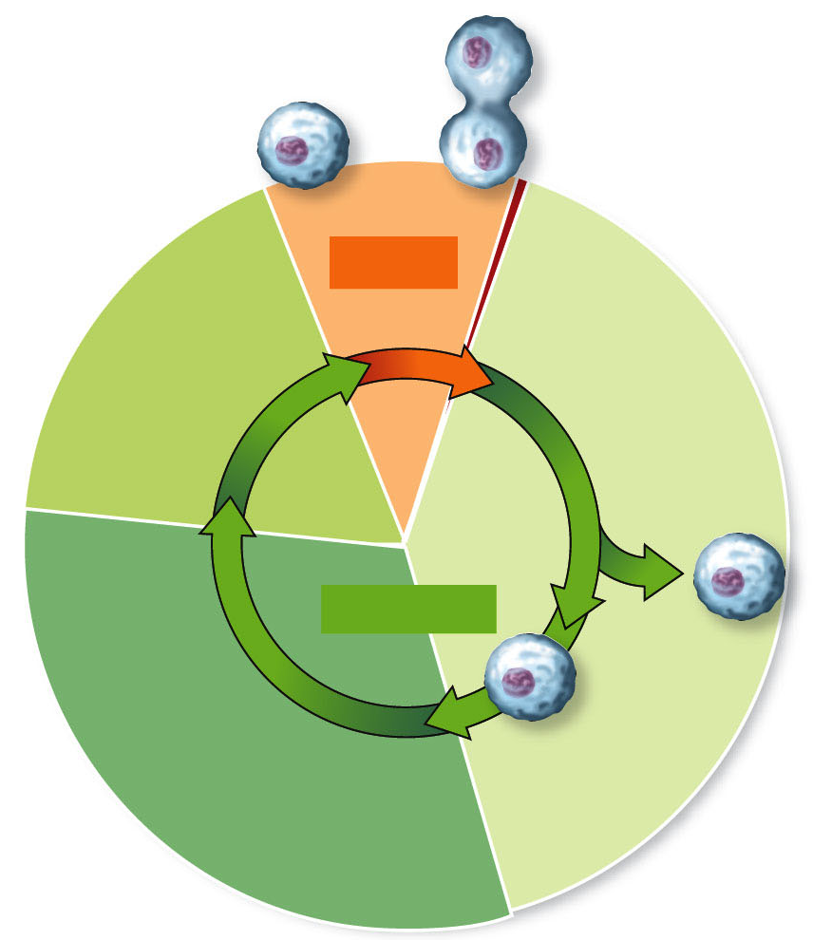
Intro to Biotech
Lect.4
How is DNA propagated ?
Eukaryotic:
Mitosis
(M)
Gap 2
(G2)
Gap 1
(G1)
Interphase
DNA synthesis
(S)

Slide 3
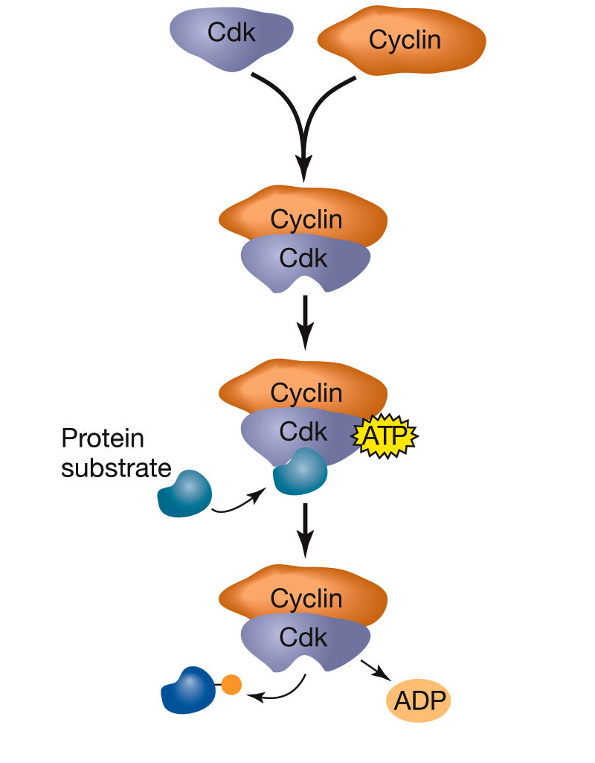
Intro to Biotech
Lect.4
How is DNA propagated ? Eukaryotic:
G2-M
transition
Mitosis
(M)
Gap 2
(G2)
Gap 1
(G1)
Interphase
DNA synthesis
(S)
Restriction
G1-S
Transition
Cell cycle
•
•
•

Slide 4
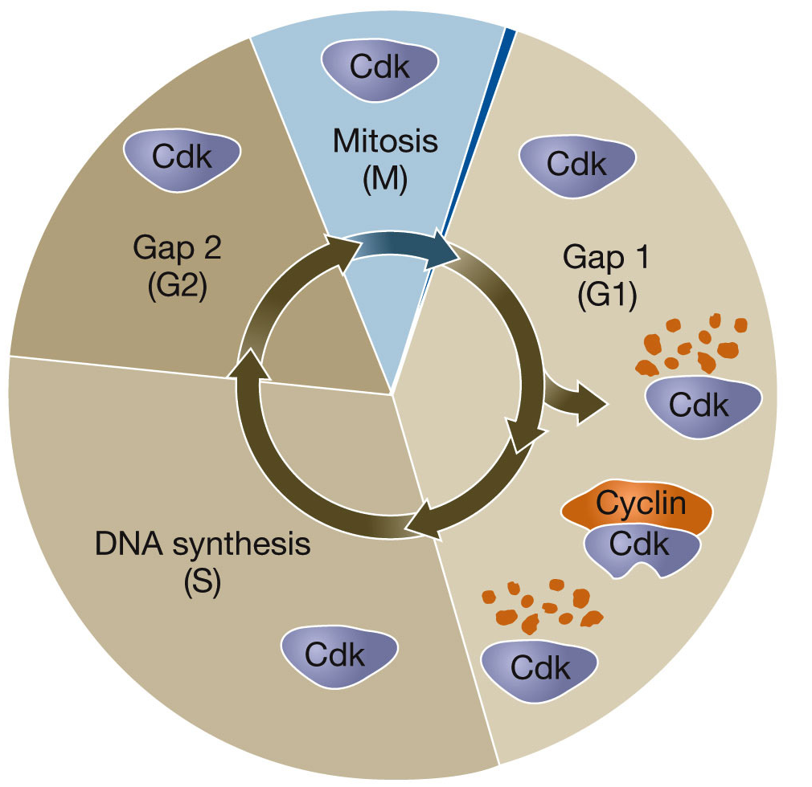
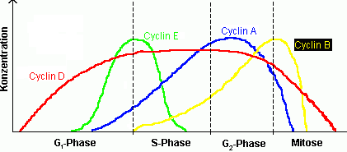
Intro to Biotech
Lect.4
How is DNA propagated ? Eukaryotic:
Cell cycle
• cyclins/CDK’s

Slide 5
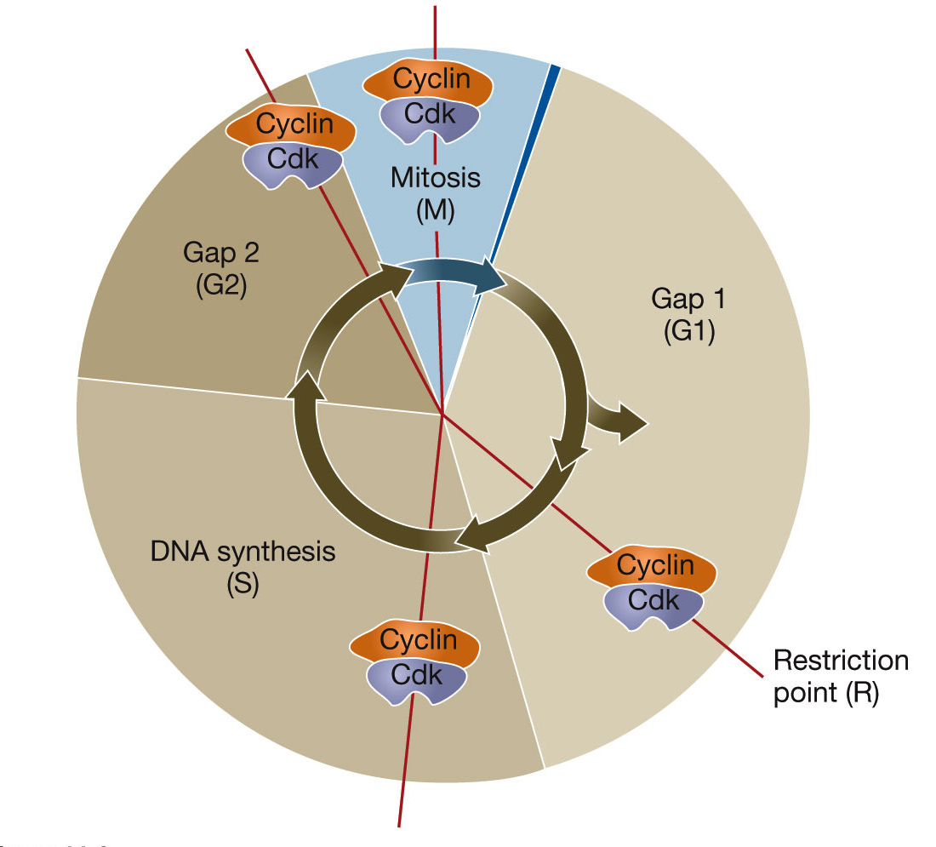
Intro to Biotech
Lect.4
How is DNA propagated ? Eukaryotic: G1-S-G2-M
G2-M transition
Rb
G1-S
Transition
Cell cycle
• cyclins/CDK’s

Slide 6
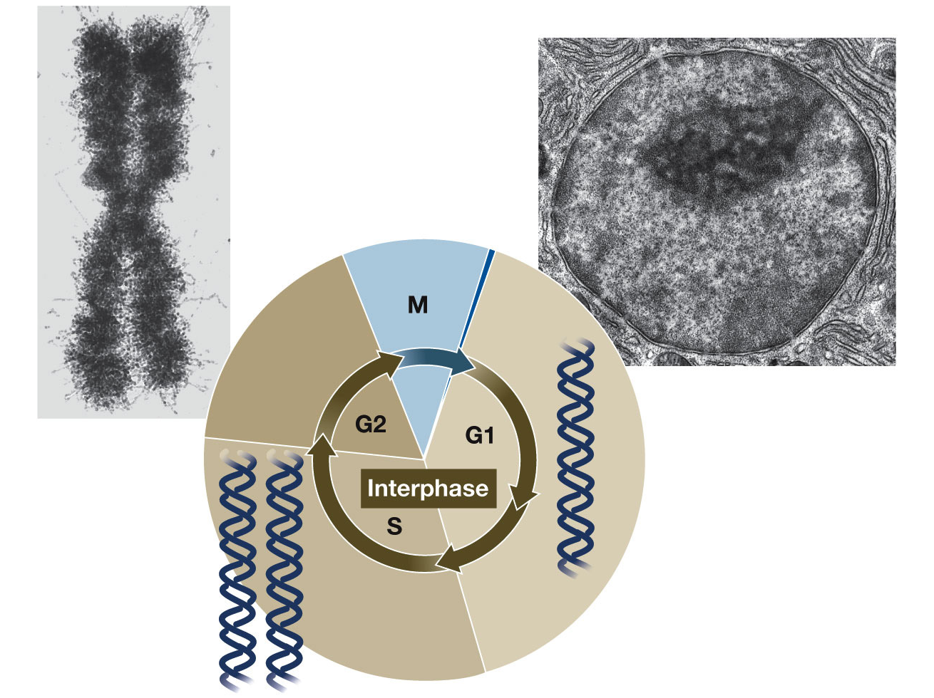
Intro to Biotech
Lect.4
How is DNA propagated ?
1. Replication
2.

Slide 7
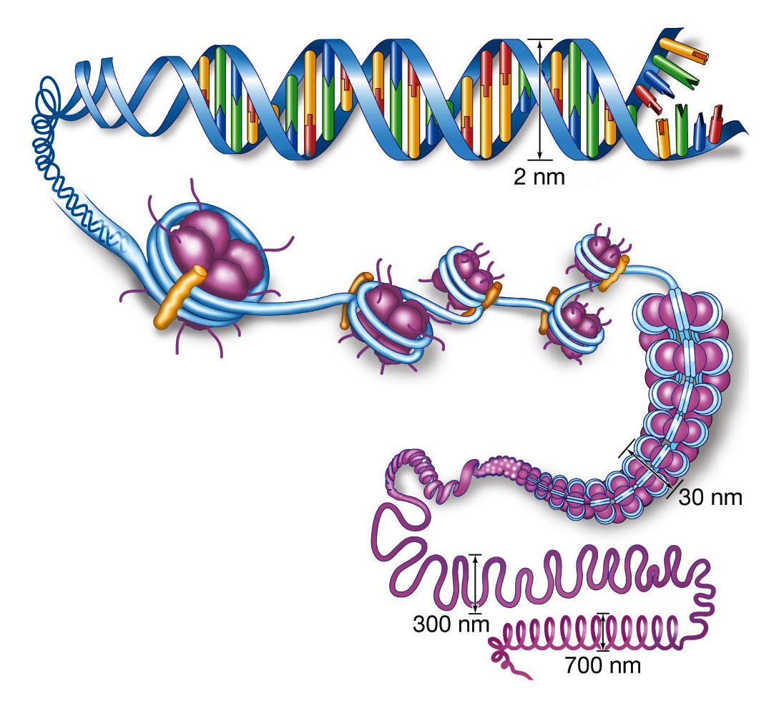
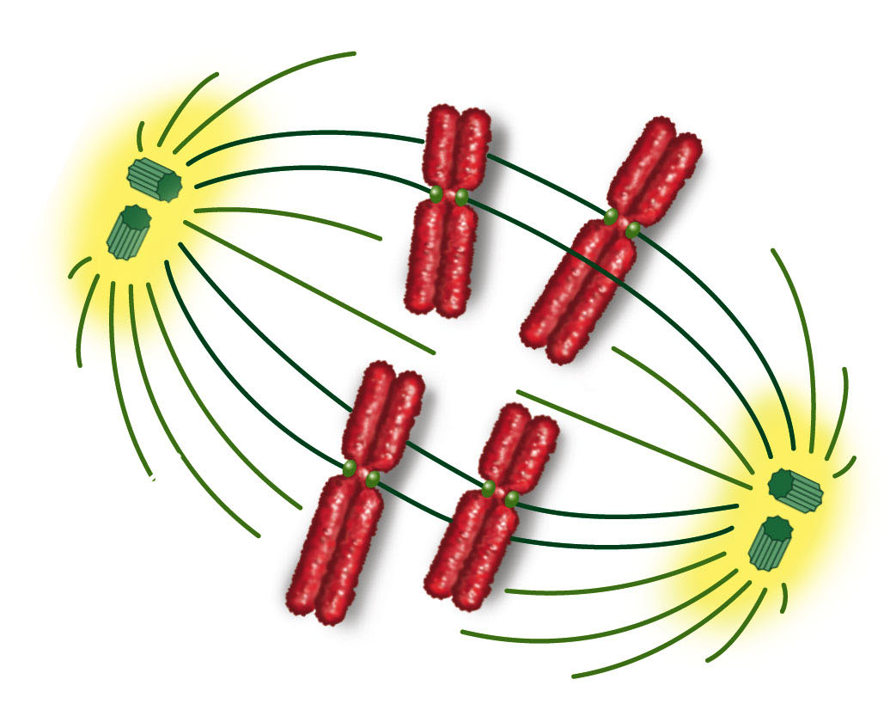
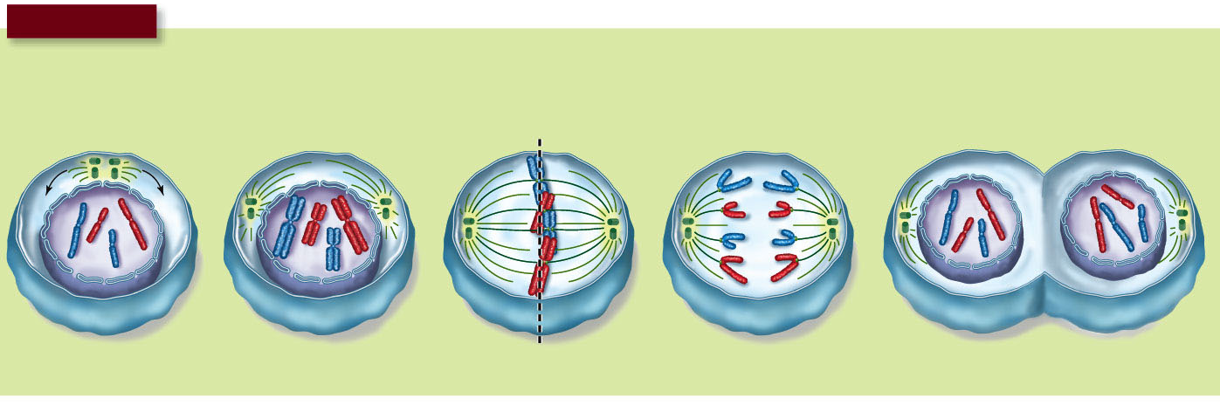
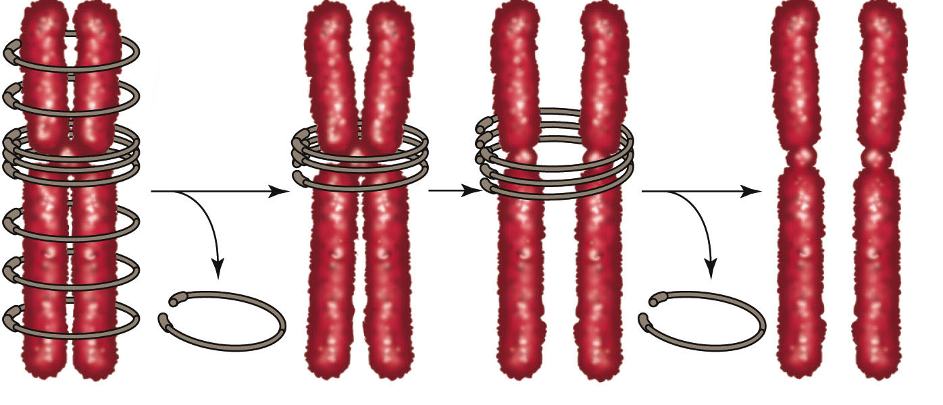
Intro to Biotech
Lect.4
How is DNA propagated ?
1. Replication
2. Segregation
H1
Nucleosome
(octamer of
histones)
Chromatin
G1-S-G2-Mitosis

Slide 8
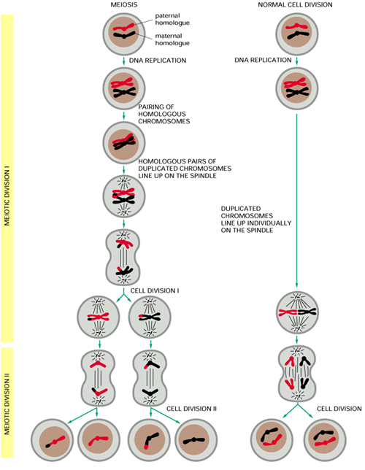
Intro to Biotech
Lect.4
How is DNA propagated ?
1. Replication
2. Segregation
Mitosis vs Meiosis
•
•
•
•
•
haploid
diploid

